Slide 1
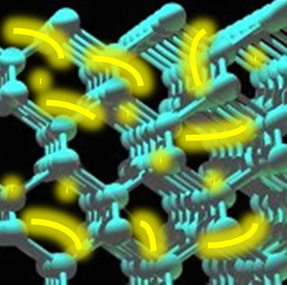
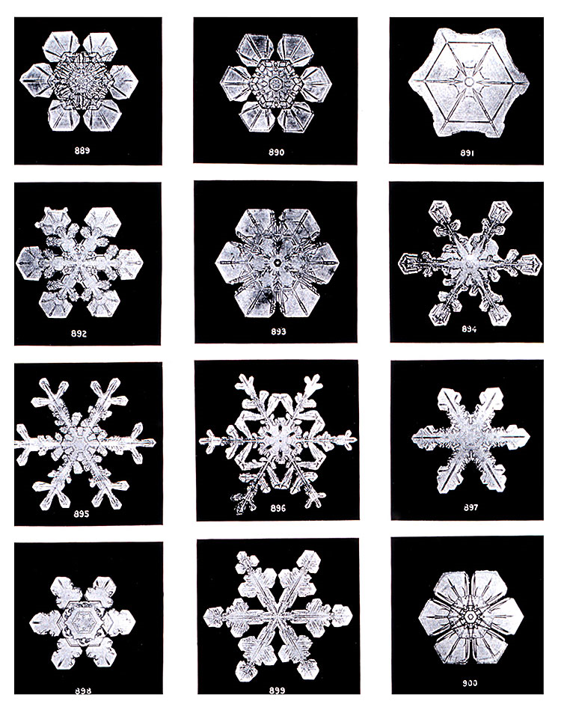
Vastestoffysica
Saskia Blom
(s.blom@fontys.nl)
Dinsdag 27/5 18:00h: gratis KNAW mini-symposium in Amsterdam https://www.facebook.com/groups/200281173447722/ https://www.knaw.nl/nl/actueel/agenda/rosetta-270514
Notes:
In semiconductors like silicon, electrons attached to atoms in the crystal lattice can be mobilized into the conduction band by light or voltage. Berkeley scientists have taken snapshots of this very brief band-gap jump and timed it at 450 attoseconds.
http://www.apptheneum.com/scientists-measure-speedy-electrons-silicon/
http://www.wetenschapsforum.nl/index.php/topic/191709-waarom-zijn-sneeuwkristallen-zo-symmetrisch/

Slide 2
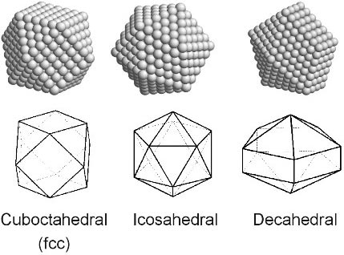
Vastestoffysica:
Toepassingen Kwantummechanica
Werking lasers
Eigenschappen metalen
Werking thermokoppel
Eigenschappen halfgeleiders
Werking diodes, LEDs, fotodiodes, zonnecellen, transistors
http://www.phys.canterbury.ac.nz/research/nano/clusters.shtml

Slide 3
Vastestoffysica:
Giancoli: Physics for Scientists and Engineers (4th ed.)
§39.6 Brehmsstrahlung (Röntgenstraling)
§39.9 Lasers
§40.2 & 40.3 Van der Waals-binding
§40.5 Vaste-stofbinding
§40.6 Fermi-energie
Geleiding, contactpotentiaal, thermokoppel,
§40.7 Energiebanden
§40.8 Dotering
§40.9 & 40.10 Diode, transistor, LED, zonnecel
Krane (Modern Physics): §11.3 & 11.7
Huiswerk op Mastering Physics
Course-id: zie Canvas
Notes:
Warmtegeleidingscoëfficiënt van metalen
Soortelijke warmte van metalen

Slide 4
Inhoud college deze week
Herhaling Kwantummechanica
Kansfunctie
Schrödingervergelijking
Vrij deeltje
(Eindige) potentiaalput
Minute Physics golf – deeltjesdualiteit: http://www.youtube.com/watch?v=Q_h4IoPJXZw
http://www.youtube.com/watch?v=_riIY-v2Ym8
Notes:
H-atoom
Periodiek systeem

Slide 5
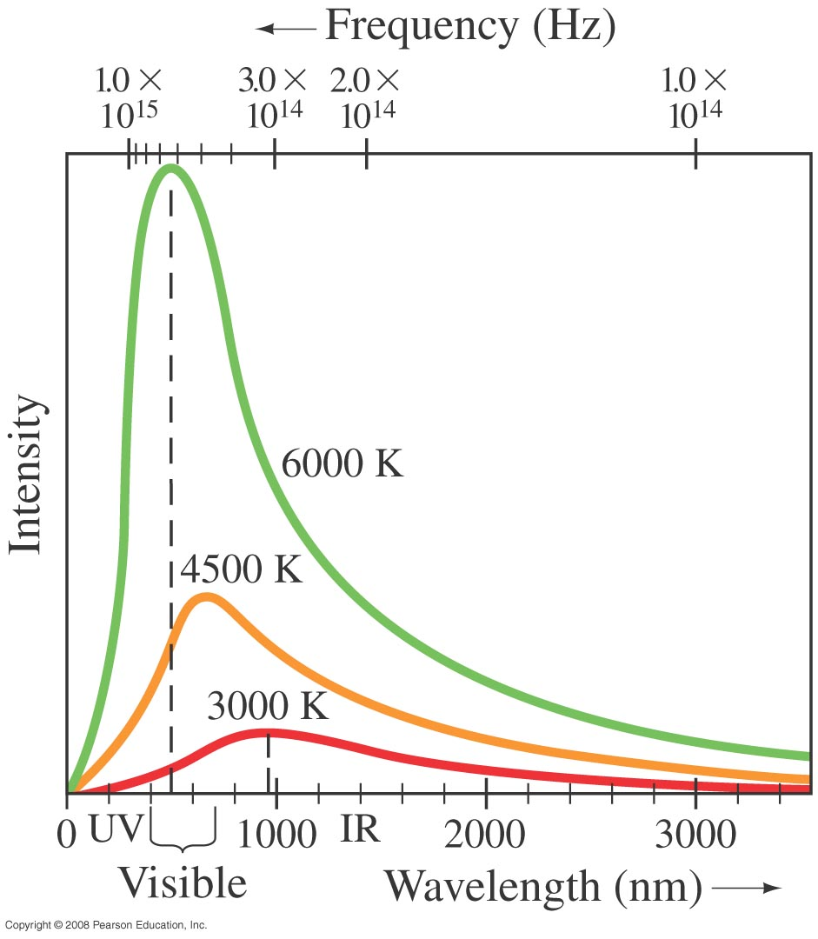
37-1 Planck’s Quantum Hypothesis; Blackbody Radiation
This figure shows blackbody radiation curves for three different temperatures. Note that frequency increases to the left. The relationship between the temperature and peak wavelength is given by Wien’s law:
Notes:
Figure 37-1. Measured spectra of wavelengths and frequencies emitted by a blackbody at three different temperatures.
Elke vrijheidsgraad heeft gemiddelde bezetting van ½ kT
Er zijn veel meer hogere-orde vibraties (# = evenredig met frequentie ˆ2) → ultraviolet catastrophe
For Planck, mechanics represented the best way to understand physics (and chemistry), and he sought a mechanical explanation of the second law, understood as an exact law of nature, on the same footing as the energy conservation law. By “mechanical”, Planck did not mean the atomistic point of view, but continuum mechanics; in fact, for a long time he considered the atomic hypothesis something irrelevant (if not nocive) for the second principle, because in the kinetic theory of gases the second law is not absolute (Maxwell demon). He stands between Boltzmann, in an extreme, who always put atomicity first, and the energeticists (Ostwald, etc.), who negated atoms (as Mach did), pretending to reduce all phenomena to different forms of energy, on the other.
The mechanical model he had in mind was rather close to the continuum aether of electromagnetism, and Planck sought to prove the second law from continuum mechanics, in particular the irreversible approach to equilibrium.
http://arxiv.org/pdf/physics/0402064.pdf

Slide 6
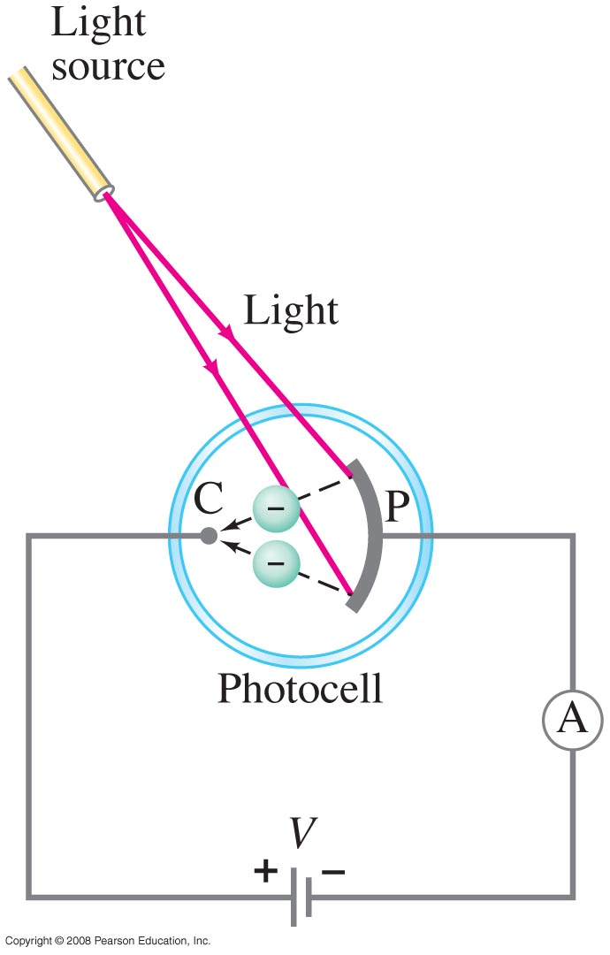
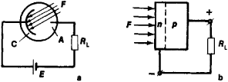
37-2 Photon Theory of Light and the Photoelectric Effect
The photoelectric effect: if light strikes a metal, electrons are emitted. The effect does not occur if the frequency of the light is too low; the kinetic energy of the electrons increases with frequency.
Figure 1. Schematic diagrams of: (a) a phototube and (b) a photocell; (C) photocathode, (A) anode, (F) luminous flux, (n) semiconductor donor region, (p) semiconductor acceptor region, (E) DC source, (R1) load resistance. The broken line denotes the p-n junction. The DC source generates an electric field, which accelerates the photo-electrons, in the space between the photocathode and the anode.
http://encyclopedia2.thefreedictionary.com/Photoelectric+Device
Photo-emissive cell
Notes:
Figure 37-4. The photoelectric effect.
C: Collector P: photo-emitter )
NB: photocell vollediger: photoemissive cell:
Phototubes operate according to the photoelectric effect: Incoming photons strike a photocathode, knocking electrons out of its surface, which are attracted to an anode. Thus current is dependent on the frequency and intensity of incoming photons. Unlike photomultiplier tubes, no amplification takes place, so the current through the device is typically of the order of a few microamperes.[
(A photoresistor or light-dependent resistor (LDR) or photocell is a light-controlled variable
resistor. The resistance of a photoresistor decreases with increasing incident light intensity; in other words, it exhibits photoconductivity.
De lichtgevoelige weerstand is gebaseerd op het foto-elektrisch effect: licht (fotonen) valt op elektronen die zich in de valentieband bevinden. Het elektron neemt de energie op en verkrijgt hierdoor voldoende energie om de verboden zone te overbruggen en van de valentieband naar de geleidingsband te springen. Daarmee is het elektron niet langer aan zijn atoom gebonden en beweegt als vrij elektron in het kristalrooster. Dit vrije elektron draagt bij aan de verhoging van de elektrische geleiding van de LDR (de verlaging van de weerstand).
Photoresistor = light-dependent resistor, LDR = photocell

Slide 7
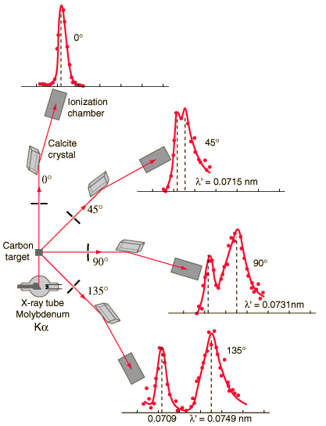
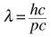
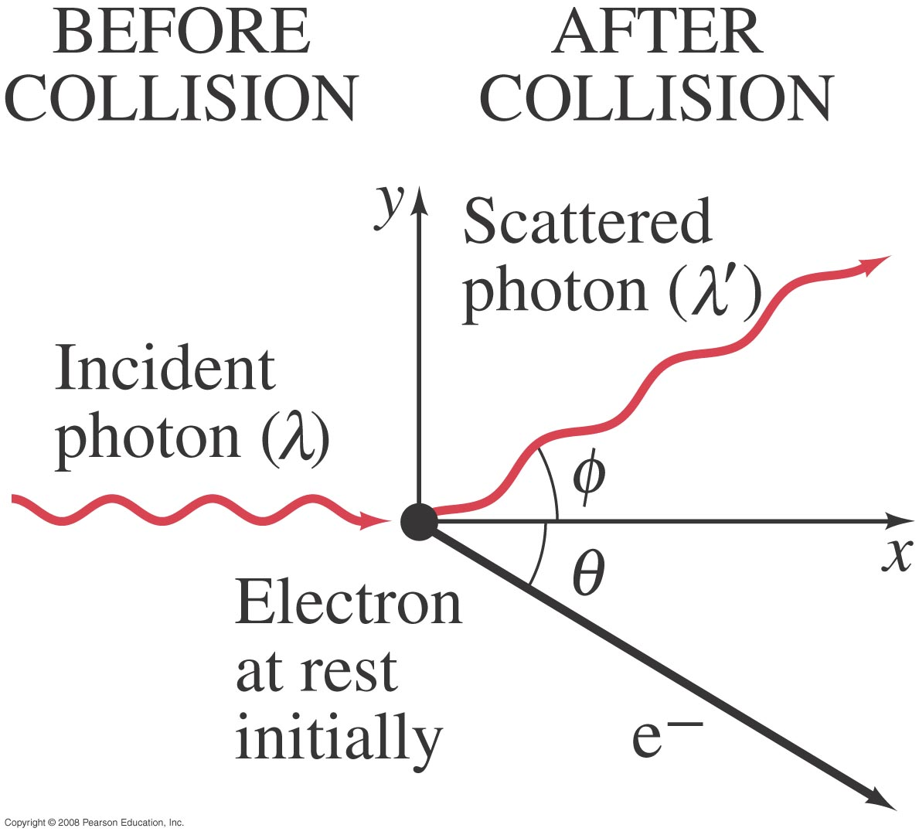
37-4 Compton Scattering
E = hc/λ = pc
This is another effect that is correctly predicted by the photon model and not by the wave model.
gebruikt om temperatuur
van plasma te meten
Notes:
Breedte piek evenredig met T, intensiteit evenredig met e⁻ - dichtheid.
Figure 37-7. The Compton effect. A single photon of wavelength λ strikes an electron in some material, knocking it out of its atom. The scattered photon has less energy (some energy is given to the electron) and hence has a longer wavelength λ’.
Compton found that some X-rays experienced no wavelength shift despite being scattered through large angles; in each of these cases the photon failed to eject an electron.^{[3]} Thus the magnitude of the shift is related not to the Compton wavelength of the electron, but to the Compton wavelength of the entire atom, which can be upwards of 10 000 times smaller.

Slide 8
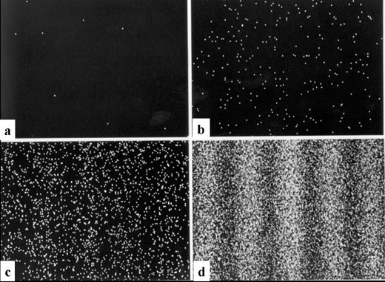
Interferentiepatroon: e⁻ één voor één door dubbele spleet
http://www.hqrd.hitachi.co.jp/em/emgif/fig2.gif

Slide 9
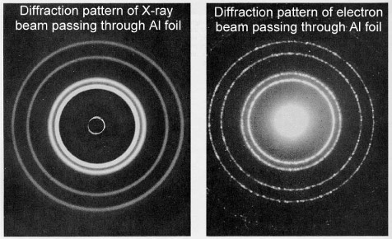
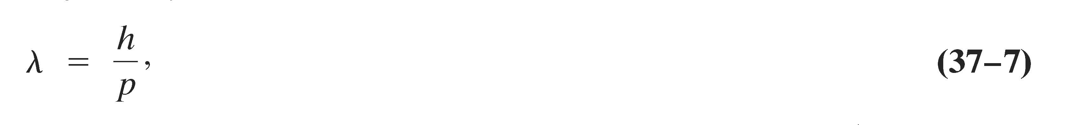
Diffractiepatronen van verschillende golven
.
http://www.mtbaker.wednet.edu/mbhs/science/physics/Quantum%20Physics/XRay%20and%20Electron%20Interference%20Patterns.htm

Slide 10
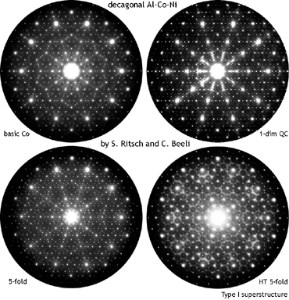
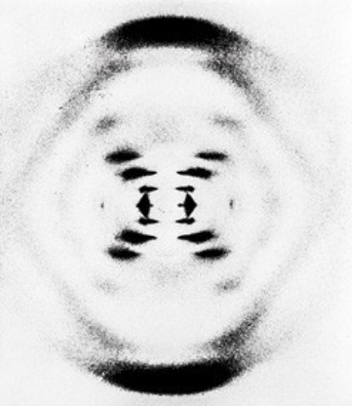
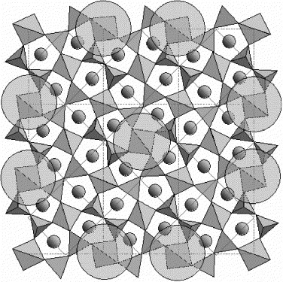
Diffractiepatronen van elektronenbundels
X-ray diffraction: DNA
The 3 × 3 superstructure of the C phase of Ca₂CoSi₂O₇. Clusters of six-fold coordinated Ca-sites are accentuated by circles.
http://www.a-levelphysicstutor.com/quantphys-electr-diffrn.php
Notes:
10 stippen → 5-voudige symmetrie
http://www.sciencedirect.com/science/article/pii/S0955221906001865
Ritsch Beeli 5-voudige symmetrie QC: QuasiCrystal

Slide 11
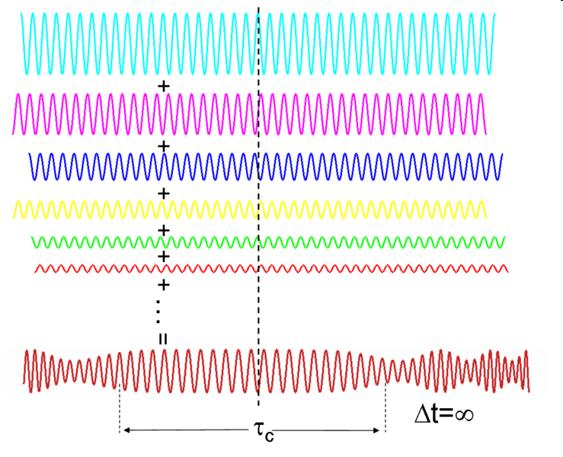
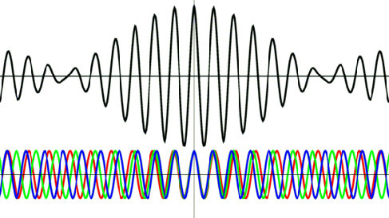
Golfpakketje (Fourierreeks)
Superpositie van monochromatische, coherente bronnen
Notes:
http://www.physik.uni-marburg.de/of/dynamics/wp.html

Slide 12
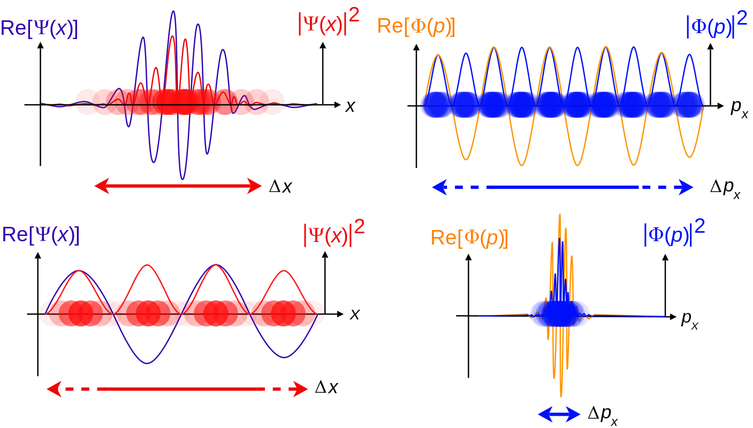
Golfpakketje
Afnemende kennis over positie → toename in kennis over impuls
positie
impuls
https://en.m.wikipedia.org/wiki/Schrödinger_equation#Wave_and_particle_motion
Notes:
Increasing levels of wavepacket localization, meaning the particle has a more localized position.
https://en.m.wikipedia.org/wiki/Schrödinger_equation#
Blue: The real part of the wave function.
Red: The probability distribution of finding the particle with this wave function at a given position.

Slide 13
Golfpakketje
Afnemende kennis over positie → toename in kennis over impuls
positie
impuls
https://en.m.wikipedia.org/wiki/Schrödinger_equation#Wave_and_particle_motion
Notes:
Increasing levels of wavepacket localization, meaning the particle has a more localized position.
https://en.m.wikipedia.org/wiki/Schrödinger_equation#
Blue: The real part of the wave function.
Red: The probability distribution of finding the particle with this wave function at a given position.

Slide 14
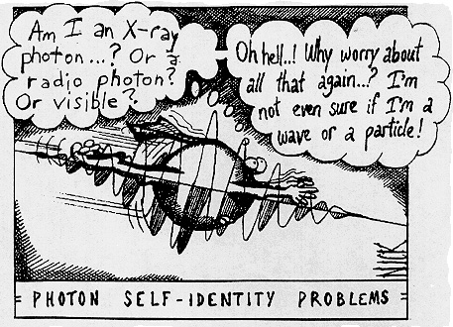
http://abyss.uoregon.edu/~js/images/wave_particle.gif
Notes:
Figure 37-29. Standing circular waves for two, three, and five wavelengths on the circumference; n, the number of wavelengths, is also the quantum number.

Slide 15
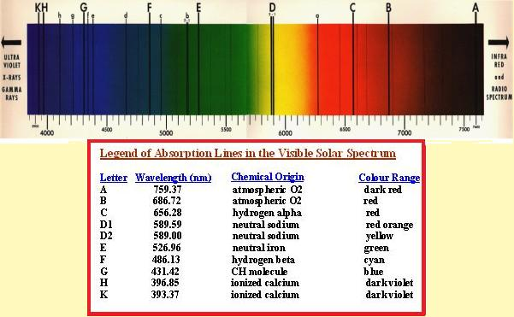
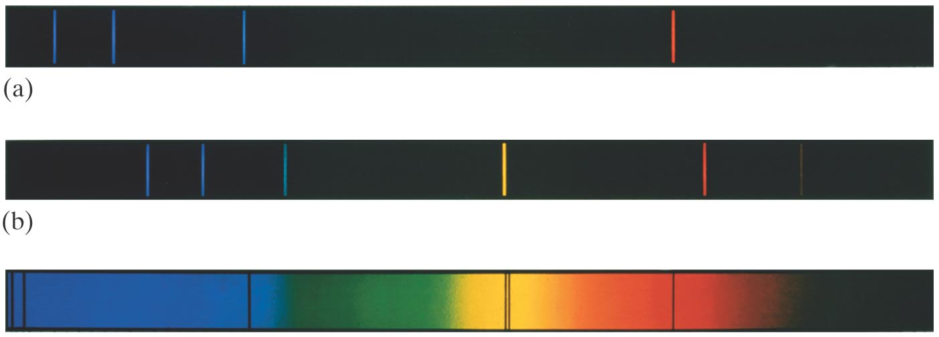
37-10 Atomic Spectra: Key to the Structure of the Atom
An atomic spectrum is a line spectrum – only certain frequencies appear. If white light passes through such a gas, it absorbs at those same frequencies.
H
H_{β}
n=4 → n=2
H_{α}
n=3 → n=2
He
Ca II
n=2 → n=4
Na
n=2 → n=3
Notes:
Figure 37-20. Emission spectra of the gases (a) atomic hydrogen, (b) helium, and (c) the solar absorption spectrum.
solar absorption spectrum: twee geioniseerd Calciumlijnen; beta-lijn H (Balmer van n=2 naar n = 4); 2 NATRIUMLIJNEN; alfa-lijn H (Balmer van n=2 naar n = 3);
http://www.tudelft-and-i.com/visible-solar-spectrum.html
Ca II: H-lijn: 4s J= ½ 4p J= ½ labda = 396,84673 nm
en K-lijn: 4s J= ½ 4p J= 3/2 labda = 393,36614 nm
n’ = 2 for the Balmer series
beta-lijn H; 486 nm
; alfa-lijn H 656 nm

Slide 16
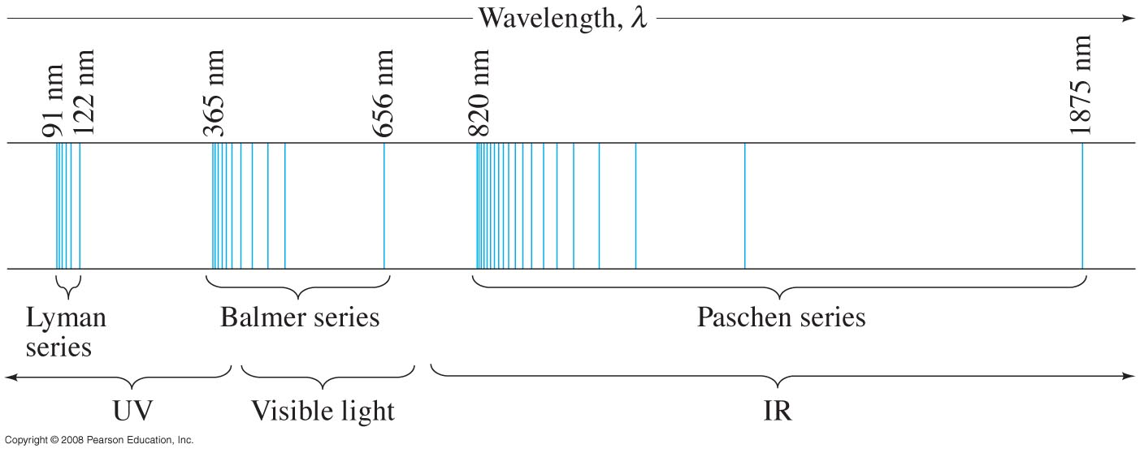
37-10 Atomic Spectra: Key to the Structure of the Atom
A portion of the complete spectrum of hydrogen is shown here.
H_{α}
H_{β}
Notes:
Figure 37-22. Line spectrum of atomic hydrogen. Each series fits the formula 1/λ = R(1/n’² – 1/n²) where n’ = 1 for the Lyman series, n’ = 2 for the Balmer series, n’ = 3 for the Paschen series, and so on; n can take on all integer values from n = n’ + 1 up to infinity. The only lines in the visible region of the electromagnetic spectrum are part of the Balmer series.
beta-lijn H; 486 nm
alfa-lijn H 656 nm

Slide 17
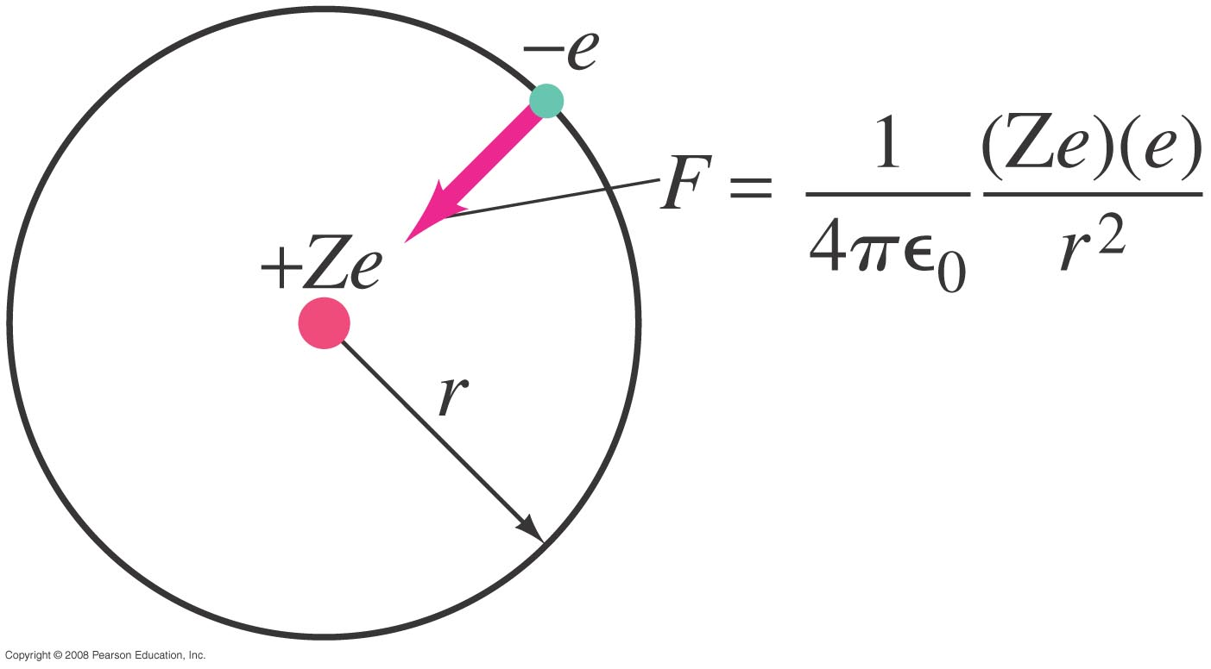
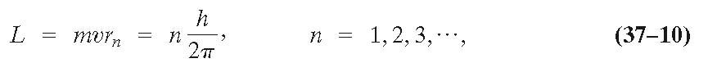
37-11 The Bohr Model
An electron is held in orbit by the Coulomb force:
angular momentum quantized:
.
Notes:
Figure 37-24. Electric force (Coulomb’s law) keeps the negative electron in orbit around the positively charged nucleus.
Bohrmodel geeft verkeerde impulmomenten!!!
Zie p. 200
Ch 7 Modern Physics by K. S. Krane
https://fisluisabraham.files.wordpress.com/2014/08/krane-k-modern-physics-3ed.pdf
(p. 215 2nd ed.)

Slide 18
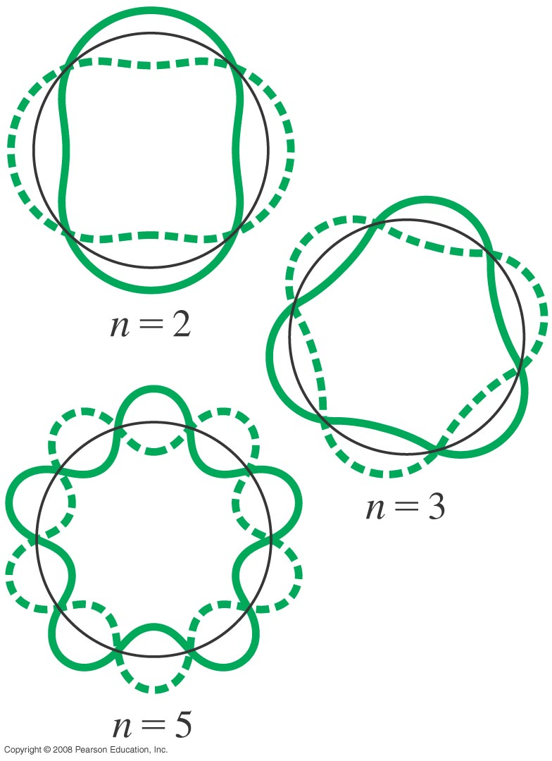

37-12 de Broglie’s Hypothesis Applied to Atoms
These are circular standing waves for n = 2, 3, and 5.
Wat golft er?
3D: http://www.falstad.com/qmrotator/
n = 8
Notes:
Figure 37-29. Standing circular waves for two, three, and five wavelengths on the circumference; n, the number of wavelengths, is also the quantum number.
- 3D: choose: mouse –> create Gaussian
- Make ellipse

Slide 19

Kwantummechanica: bizar
Kansfunctie
Notes:
http://arstechnica.com/science/news/2011/11/the-insanely-weird-quantum-wave-function-might-be-real-after-all.ars
http://www.fark.com/comments/7053721/76269389#c76269389

Slide 20
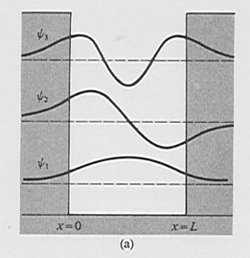
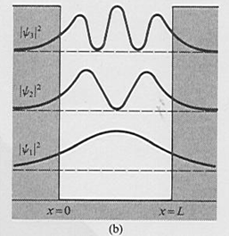
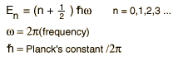
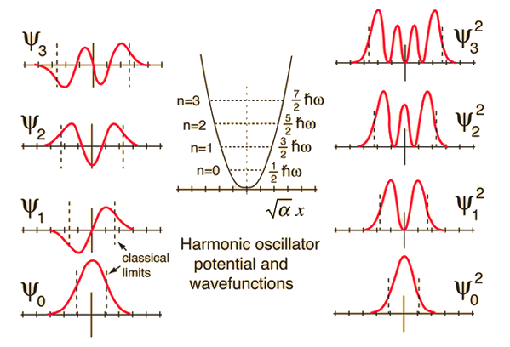
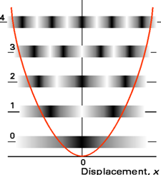
Golffunctie en kansdichtheid
(on)eindig
diepe put?
https://www.st-andrews.ac.uk/physics/quvis/simulations_html5/sims/finite-infinite-well/finite-infinite-well.html
Notes:
http://hyperphysics.phy-astr.gsu.edu/hbase/quantum/hosc7.html
quantum harmonic oscillator: has a so-called zero-point vibration" of the n=0 ground state.
In a box (quantum well) n cannot be zero, sincs the energy cannot be exactly zero.

Slide 21
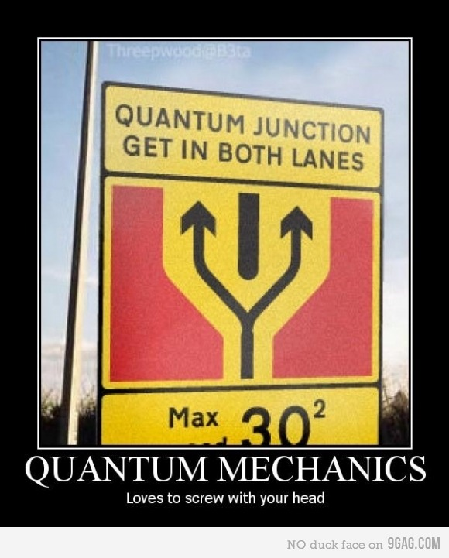
http://173.230.153.248/gag/399767

Slide 22
Quiz
Waarom plakt het e⁻ in een H-atoom niet aan de positieve kern?
a) Vanwege het uitsluitingsprincipe van Pauli.
Vanwege de onzekerheidsrelatie van Heisenberg.
De kinetische energie van het elektron is te laag.
Zowel a als b.
Phet applet radiating charge:
http://phet.colorado.edu/en/simulation/radiating-charge

Slide 23
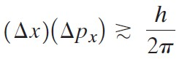
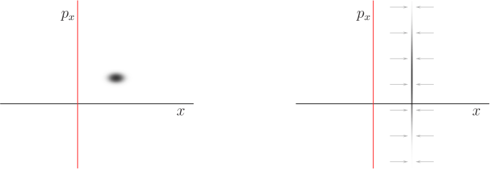

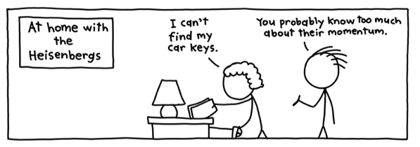
Onzekerheidsrelatie van Heisenberg.
Standaarddeviaties in x en p_{x}:
Notes:
It is often said that delta p_x gives a measure of the magnitude of the momentum of the particle.
It is in effect a root-mean-square value of p_x, which can be taken to be a rough measure of the magnitude of p_x.
Zie p. 117 (fig 4.22)
Ch 4.4 Modern Physics by K. S. Krane

Slide 24
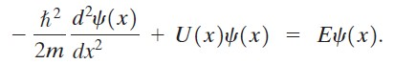
Vrij deeltje
Vrij deeltje
Schrödinger:
U ( x ) = 0 ⬆
⬆ definitie van het golfgetal k
http://www.eng.fsu.edu/~dommelen/quantum/style_a/classic.html
Notes:
The blue point indicates the position of maximum wave function magnitude, as a visual anchor. It provides a reasonable approximation to the expectation value of position whenever the wave packet contour is more or less symmetric. A closer examination shows that the wave packet is actually changing a bit in size in addition to translating.

Slide 25
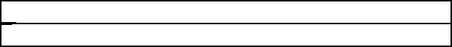
Vrij deeltje
Vrij deeltje
Schrödinger:
⬆ definitie van het golfgetal k
http://www.eng.fsu.edu/~dommelen/quantum/style_a/classic.html
Notes:
The blue point indicates the position of maximum wave function magnitude, as a visual anchor. It provides a reasonable approximation to the expectation value of position whenever the wave packet contour is more or less symmetric. A closer examination shows that the wave packet is actually changing a bit in size in addition to translating.

Slide 26
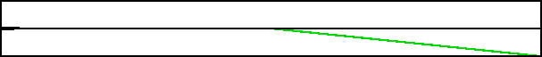
Versnelde beweging
Gradiënt in de potentiaal:
Wat gebeurt er?
(t.a.v. positie / snelheid, golflengte / impuls)
U_{max}
U_{min}
Nu: in plaats van heuvel af,
opklimmende gradiënt in de potentiaal (E_{kin} < U_{max})
Wat gebeurt er?

Slide 27
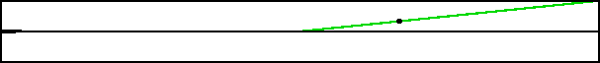
Vertraagde beweging
Opklimmende gradiënt in de potentiaal (E_{kin} < U_{max}):
Wat gebeurt er?
(t.a.v. positie / snelheid, golflengte / impuls)
U_{max}
Notes:
The black dot on the potential energy line shows the “turning point” where the potential energy becomes equal to the nominal energy of the wave packet.

Slide 28
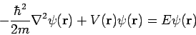
Schrödingervergelijking (1D, tijdonafhankelijk)
(Energiebehoud, niet relativistisch)
We nemen aan:
In 3 dimensies:

Slide 29
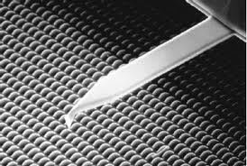
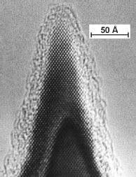
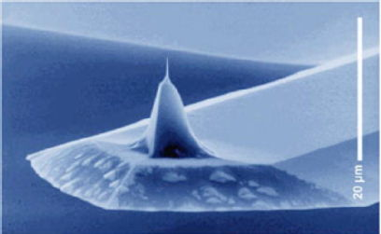
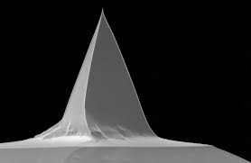
Huiswerk
Doorlezen: Giancoli Ch 37, Ch 38 + § 39 1-5 (voorkennis)
Maak in Mastering Physics ‘week 1’
Maak Problems: 37_{42,49,57} ; 38_{7,13,23,34,39}
huiswerkbespreking:
welkom mits voorbereid!
SEM
TEM
Notes:
Atomic Force Microscopy (AFM)
SEM and TEM images of a micromachined silicon cantilever with an integrated tip pointing in the [001] crystal direction.
http://www2.warwick.ac.uk/fac/sci/physics/current/postgraduate/regs/mpags/ex5/techniques/structural/afm/
scanning electron microscope (SEM): cantilever near a house fly compound eye
Transmission electron microscopy (TEM)
High quality samples will have a thickness that is comparable to the mean free path of the electrons that travel through the samples, which may be only a few tens of nanometers.
Preparation of TEM specimens is specific to the material under analysis and the desired information to obtain from the specimen.
samples may be held at liquid nitrogen temperatures after embedding in vitreous ice.
A low-voltage electron microscope (LVEM) is operated at relatively low electron accelerating voltage between 5–25 kV.

Slide 30
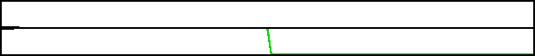
Sterk versnelde beweging
Snel dalende gradiënt in de potentiaal (t.o.v. golflengte):
Wat gebeurt er?
(t.a.v. positie / snelheid, golflengte / impuls)
Reflectie en transmissie!

Slide 31
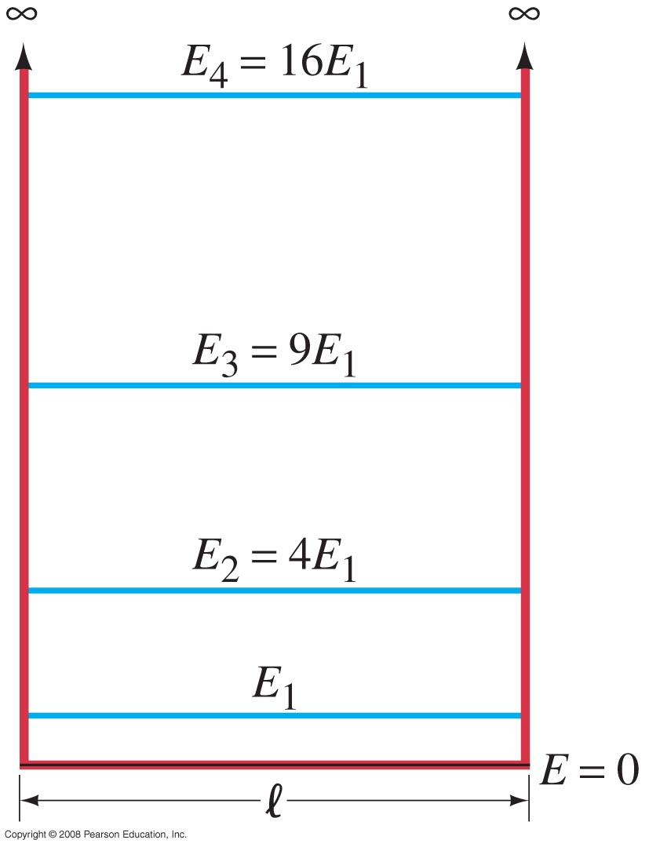
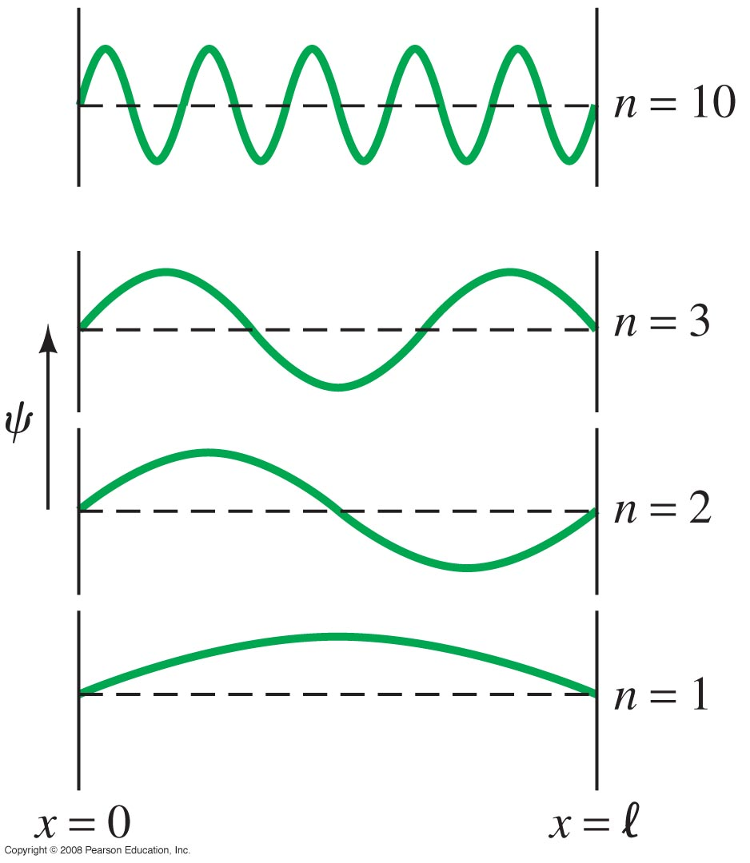
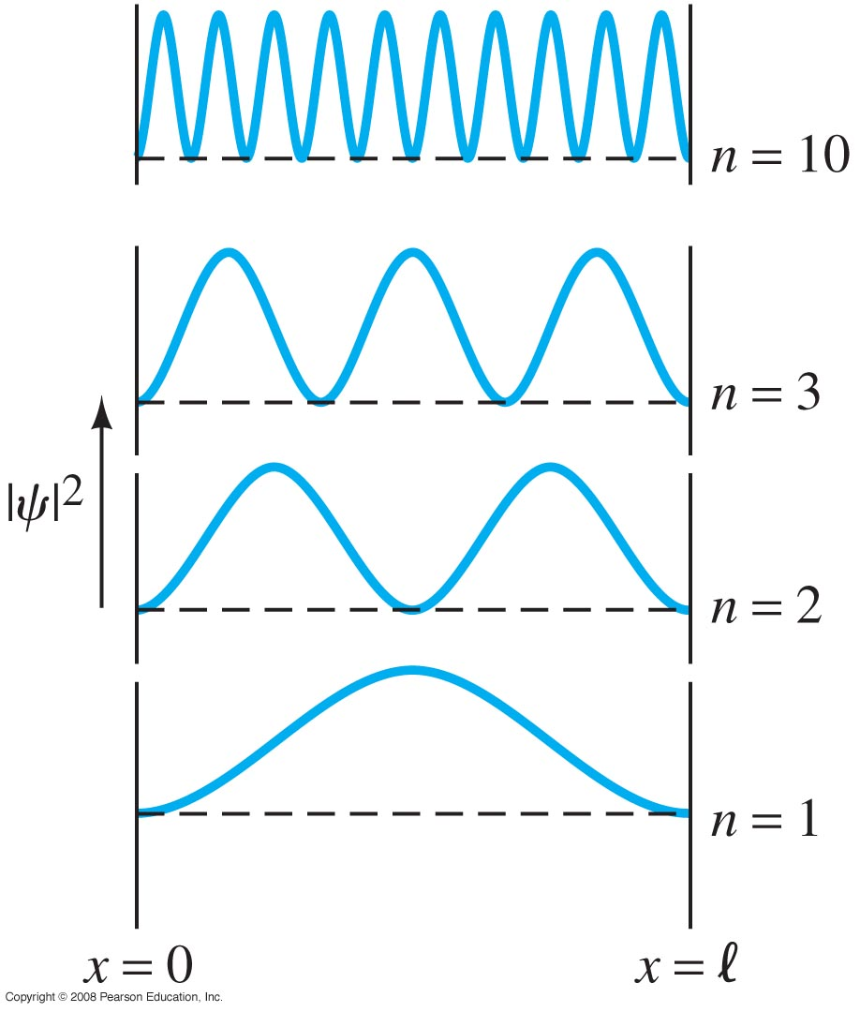
38.8 Particle in an Infinitely Deep Square Well Potential (a Rigid Box)
These plots show the energy levels, wave function, and probability distribution for several values of n.
ψ = 0 at x = 0 and x = gives B = 0 and k = nπ/
kans ⬇
Notes:
Figure 38-8. Possible energy levels for a particle in a box with perfectly rigid walls (infinite square well potential).
Figure 38-9. Wave functions corresponding to the quantum number n being 1, 2, 3 and 10 for a particle confined to a rigid box.
Figure 38-10. The probability distribution for a particle in a rigid box for the states with n = 1, 2, 3, and 10.

Slide 32
Gewoonte bij kwantummechanica:
Tekenen van golffunctie rond energieniveau
(➔ energieniveau is nulpunt van amplitude golffunctie)
Let op: hoogte amplitude heeft geen betekenis t.o.v hoogte van de potentiaal!

Slide 33
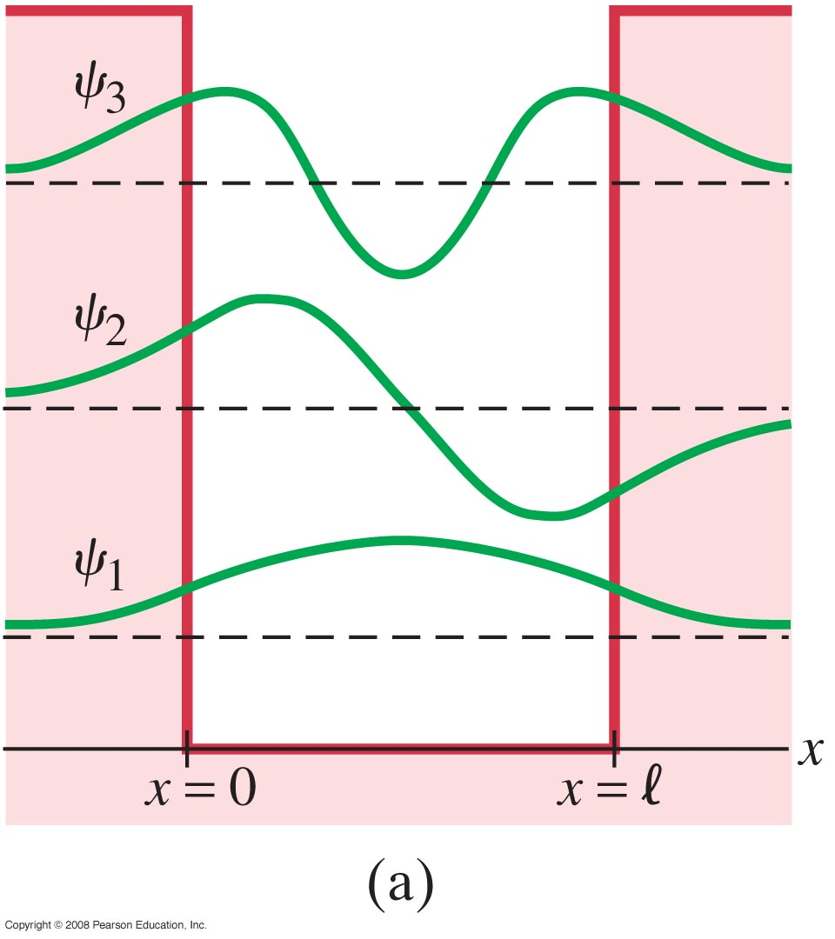
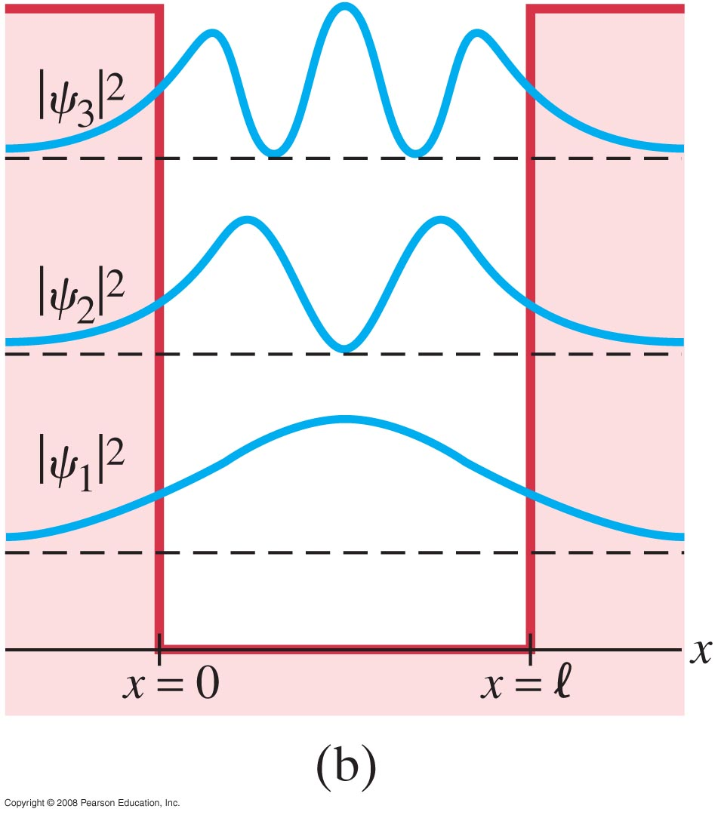
38.9 Finite Potential Well
wave functions and probability distributions for the first three energy states.
ψ en dψ/dx
continu
Figure 38-13a goes here.
Figure 38-13b goes here.
Notes:
Figure 38-13. The wave functions (a), and probability distributions (b), for the three lowest possible states of a particle in a finite potential well. Each of the ψ and |ψ|² curves has been superposed on its energy level (dashed lines) for convenience.

Slide 34
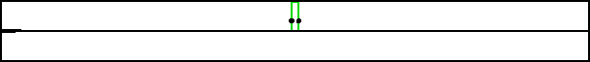
Tunnelen
Smalle barrière (blok-potentiaal):
Wat gebeurt er?
(t.a.v. positie / snelheid, golflengte / impuls)
Ook hier: reflectie en transmissie
Notes:
The black dot on the potential energy line shows the “turning point” where the potential energy becomes equal to the nominal energy of the wave packet.

Slide 35

38.10 Tunneling Through a Barrier
eindig hoge barrière
The probability that a particle tunnels through a barrier can be expressed as a transmission coefficient, T, and a reflection coefficient, R (where T + R = 1). If T is small,
The smaller E is with respect to U₀, the smaller the probability that the particle will tunnel through the barrier.
Voorbeelden van tunnelen?

Slide 36




38.10 Tunneling Through a Barrier
Alpha decay is a tunneling process; this is why alpha decay lifetimes are so variable.
Scanning tunneling microscopes image the surface of a material by moving so as to keep the tunneling current constant. In doing so, they map an image of the surface.
Figure 38-18 goes here.
http://hyperphysics.phy-astr.gsu.edu/hbase/Nuclear/alptun.html
Notes:
Figure 38-18. Probe tip of a scanning tunneling microscope, as it is moved horizontally, moves up and down to maintain a constant tunneling current, producing an image of the surface.
Silicon atoms on a surface via scanning tunneling microscopy, STM. http://www.exo.net/~pauld/workshops/Atoms.html

Slide 37



Frustrated Total internal Reflection

Slide 38


39.2 Hydrogen Atom: Schrödinger Equation and Quantum Numbers
aanwijzing voor meer vrijheidsgraden!
In a magnetic field, the energy levels split depending on m .
Zeeman-effect
Notes:
Figure 39-4. When a magnetic field is applied, an n = 3, l = 2 energy level is split into five separate levels, corresponding to the five values of m_{l} (2, 1, 0, -1, -2). An n = 2, l = 1 level is split into three levels (m_{l} = 1, 0 , -1). Transitions can occur between levels (not all transitions are shown), with photons of several slightly different frequencies being given off (the Zeeman effect).

Slide 39






39.2 Hydrogen Atom: Schrödinger Equation and Quantum Numbers
orbital angular momentum L and electron spin angular momentum S are combined to produce the total angular momentum
The magnetic quantum number, m , gives the direction of the electron’s angular momentum, and can take on integer values from – to + .
x- en y-richting van L onbepaald
= 2
Notes:
Since the angular momenta are quantum operators, they cannot be drawn as vectors like in classical mechanics. Nevertheless, it is common to depict them heuristically in this way. Depicted on the right is a set of states with quantum numbers , and for the five cones from bottom to top. Since |L|=sqrt(6)* h/ , the vectors are all shown with length sqrt(6)* h/. The rings represent the fact that Lz is known with certainty, but Lx and Ly are unknown; therefore every classical vector with the appropriate length and z-component is drawn, forming a cone. The expected value of the angular momentum for a given ensemble of systems in the quantum state characterized by l and m_l could be somewhere on this cone while it cannot be defined for a single system (since the components of L do not commute with each other). http://en.wikipedia.org/wiki/Angular_momentum_operator#Visual_interpretation
If we know Lz exactly (Lz = 0), then we have no knowledge at all of the angle φ—all values are equally probable. This is equivalent to saying that we know nothing at all about Lx and Ly; whenever one component of L is determined, the other components are completely undetermined.
On the other hand, if we try to construct an angular momentum state in which a different component — for example, Lx — is completely specified (so that φ would be known), the state becomes a mixture or superposition of different Lz values. In effect, we can reduce the uncertainty in φ only at the expense of increasing the uncertainty in Lz.
Ch 7.2 Modern Physics by K. S. Krane
https://fisluisabraham.files.wordpress.com/2014/08/krane-k-modern-physics-3ed.pdf

Slide 40



39.3 Hydrogen Atom Wave Functions
Example 39-3: Most probable electron radius in hydrogen.
Determine the most probable distance r from the nucleus at which to find the electron in the ground state of hydrogen.
P_{r} (dV) = |ψ|² dV
Differentiate P_{r}(r) with respect to r,
set it equal to zero, and solve for r.
The answer is r = r₀.
Notes:
Solution: Differentiate P_{r}(r) with respect to r, set it equal to zero, and solve for r. The answer is r = r₀.

Slide 41
39.3 Hydrogen Atom Wave Functions
Example 39-4: Calculating probability.
Determine the probability of finding the electron in the ground state of hydrogen within two Bohr radii of the nucleus.
Integrate P_{r}(r) from 0 to 2r₀.
The wave function is already normalized
The probability is 0.76
Notes:
Solution: Integrate P_{r}(r) from 0 to 2r₀. The wave function is already normalized. Solution: the probability is 0.76.

Slide 42

39.3 Hydrogen Atom Wave Functions
This figure shows the probability distributions for n = 1 and = 0
https://tomasbzdusek.wordpress.com/
Notes:
Since the angular momenta are quantum operators, they cannot be drawn as vectors like in classical mechanics. Nevertheless, it is common to depict them heuristically in this way. Depicted on the right is a set of states with quantum numbers , and for the five cones from bottom to top. Since |L|=sqrt(6)* h/ , the vectors are all shown with length sqrt(6)* h/. The rings represent the fact that Lz is known with certainty, but Lx and Ly are unknown; therefore every classical vector with the appropriate length and z-component is drawn, forming a cone. The expected value of the angular momentum for a given ensemble of systems in the quantum state characterized by l and m_l could be somewhere on this cone while it cannot be defined for a single system (since the components of L do not commute with each other). http://en.wikipedia.org/wiki/Angular_momentum_operator#Visual_interpretation
If we know Lz exactly (Lz = 0), then we have no knowledge at all of the angle φ—all values are equally probable. This is equivalent to saying that we know nothing at all about Lx and Ly; whenever one component of L is determined, the other components are completely undetermined.
On the other hand, if we try to construct an angular momentum state in which a different component — for example, Lx — is completely specified (so that φ would be known), the state becomes a mixture or superposition of different Lz values. In effect, we can reduce the uncertainty in φ only at the expense of increasing the uncertainty in Lz.
Ch 7.2 Modern Physics by K. S. Krane
https://fisluisabraham.files.wordpress.com/2014/08/krane-k-modern-physics-3ed.pdf

Slide 43



39.3 Hydrogen Atom Wave Functions
This figure shows several probability distributions
1s
2p_x
= 1 ??
3d_xy
2s
https://tomasbzdusek.wordpress.com/
Notes:
Solution: Differentiate P_{r}(r) with respect to r, set it equal to zero, and solve for r. The answer is r = r₀.

Slide 44


39.3 Hydrogen Atom Wave Functions
This figure shows the three probability distributions for n = 2 and = 1 (the distributions for m = +1 and m = -1 are the same), as well as the radial distribution for all n = 2 states.
Notes:
Figure 39-9. (a) The probability distribution for the three states with n = 2, l = 1. (b) Radial probability distribution for the sum of the three states with n = 2, l = 1, and m_{l} = +1, 0, or –1.
kansfunctie 211 optellen bij kansfunctie 21-1 (en normeren) geeft plaatje als 210, maar dan symmetrisch rond x-as
kansfunctie 211 aftrekken van kansfunctie 21-1 (en normeren) geeft plaatje als 210, maar dan symmetrisch rond y-as
Zie slide 8 van http://richardloosemore.com/docs/PHYS302/PHYS302_Modern_17.pdf

Slide 45


39.3 Hydrogen Atom Wave Functions
This figure shows the three probability distributions for n = 2 and = 1 (the distributions for m = +1 and m = -1 are the same),
p_x + i*p_y and the p_x – i*p_y orbitals
https://tomasbzdusek.wordpress.com/
Notes:
Figure 39-9. (a) The probability distribution for the three states with n = 2, l = 1. (b) Radial probability distribution for the sum of the three states with n = 2, l = 1, and m_{l} = +1, 0, or –1.
kansfunctie 211 optellen bij kansfunctie 21-1 (en normeren) geeft plaatje als 210, maar dan symmetrisch rond x-as
kansfunctie 211 aftrekken van kansfunctie 21-1 (en normeren) geeft plaatje als 210, maar dan symmetrisch rond y-as
Zie slide 8 van http://richardloosemore.com/docs/PHYS302/PHYS302_Modern_17.pdf

Slide 46

39.3 Hydrogen Atom Wave Functions
More general: the probability distributions for
n = 1 and = 0
n = 2 and = 1
combinatie van de 1s en 2p_{x} subschil
3D: http://www.falstad.com/qmrotator/
Notes:
Solution: Differentiate P_{r}(r) with respect to r, set it equal to zero, and solve for r. The answer is r = r₀.

Slide 47
Quiz
Waarom zitten de e⁻ van een C-atoom niet alle zes in de 1^{s}-schil? (1^{s}-schil = K-schil: grondtoestand, n=1)
a) Vanwege het uitsluitingsprincipe van Pauli.
b) Vanwege de onzekerheidsrelatie van Heisenberg.
De energie van vier van de elektronen is te hoog.
Zowel a als b.

Slide 48
39.4 Complex Atoms; the Exclusion Principle
In order to understand the electron distributions in atoms, another principle is needed. This is the Pauli exclusion principle:
No two electrons in an atom can occupy the same quantum state.
The quantum state is specified by the four quantum numbers; no two electrons can have the same set.
Fermionen (elektron, neutron, proton) zijn altijd te onderscheiden,
Bosonen (foton, fonon, gluon, Higgs-deeltje) juist niet

Slide 49

39.5 The Periodic Table of the Elements
Conceptual Example 39-5: Electron configurations.
Which of the following electron configurations are possible, and which are not:
(a) 1s²2s²2p⁶3s³;
(b) 1s²2s²2p⁶3s²3p⁵4s²;
(c) 1s²2s²2p⁶2d¹?
n
# e⁻
Notes:
Solution: a. Not possible; too many electrons in s subshell of M (n = 3) shell (3 shown; 2 is the maximum).
b. Possible but an excited state; one 3p electron has jumped to 4s. There are 19 electrons; this is potassium.
c. Not possible; no d (l = 2) subshell in the n = 2 shell.

Slide 50

39.2 Hydrogen Atom: Schrödinger Equation and Quantum Numbers
“Allowed” transitions between energy levels occur between states whose value of differ by one:
Other, “forbidden,” transitions also occur but with much lower probability.
(due to conservation of angular momentum)
toegestaan: 3^{p} → 1^{s}
2^{p} → 1^{s}
maar: 3^{p} → 2^{p} verboden (Δ = 0)
3^{d} → 3^{s} verboden (Δ = 2)
Notes:
l=2-state → l =1 of l=3, niet l= 2 of l = 0
Photon carries angular momentum 1 * ħ (h-bar) → delta l = 1

Slide 51
39.2 Hydrogen Atom: Schrödinger Equation and Quantum Numbers
Example 39-2: E and L for n = 3.
Determine (a) the energy and (b) the orbital angular momentum for an electron in the hydrogen atom states whose principal quantum number is n = 3.
a. The energies of all the states are the same since they have the same n:
E = -1.51 eV.
b. For = 0, L = 0; for = 1, L = √2 ħ; for = 2, L = √6 ħ.
Conceptual Example 39-1: Possible states for n = 3.
How many different states are possible for an electron whose principal quantum number is n = 3?
Notes:
Solution: a. The energies of all the states are the same since they have the same n: E = -1.51 eV.
b. For l = 0, L = 0; for l = 1, L = √2 ħ; for l = 2, L = √6 ħ.

Slide 52


Herhaalde voorkennis
Golffunctie (beschrijft kans op meetresultaat)
Schrödingervergelijking
(on)eindig diepe potentiaalput
Tunneling
Heisenbergonzekerheid
Pauli-uitsluitingsprincipe
Energietoestanden atoom
Fluorescentie
Molecuulbinding
Moleculaire spectra
http://en.wikipedia.org/wiki/Zero-phonon_line_and_phonon_sideband
http://www.eng.fsu.edu/~dommelen/quantum/style_a/harm.html

Slide 53
Schrödingervergelijking (1D, tijdafhankelijk)
tijdonafhankelijke
oplossing
Wat is het klassieke equivalent?
Newton: F = m a
http://www.physnet.org/modules/pdf_modules/m248.pdf
http://www.eng.fsu.edu/~dommelen/quantum/style_a/schrod.html
Notes:
Newton: d(mv)/dt = m a = F

Slide 54
Quiz
is gelokaliseerd in plaats en tijd
heeft een bepaalde massa
- heeft een bepaalde impuls
- heeft een bepaalde energie
Dit zijn de kenmerken van:
a) een deeltje.
b) een golf
zowel a als b.
kenmerken golf: frequentie / golflengte, amplitude / intensiteit
energiedichtheid; impuls ligt minder voor de hand

